Slide 1
Student Organization System (SOS)
Team Members:
Armando J. Ochoa – Primary Facilitator
Yovanni Jones - Developer
Anthony Sanchez-Ayra – Team Leader
Teriq Douglas – Minute Taker
M.Kian Maroofi – Time Keeper
Date: 10/01/2019

Slide 2
Purpose and Scope of System
Provide a single point of access for all users
Collating all organizations a user belongs to.
Presenting users with events that are nearby.
Connecting users with new organizations and other members.
Organizes all members of a club under a single network.
Provides tools to manage organization leader and their privileges.
Provides means to create and advertise organization-related events.
Scope:
University clubs and organizations.
University students
Monitor/administering parties.

Slide 3
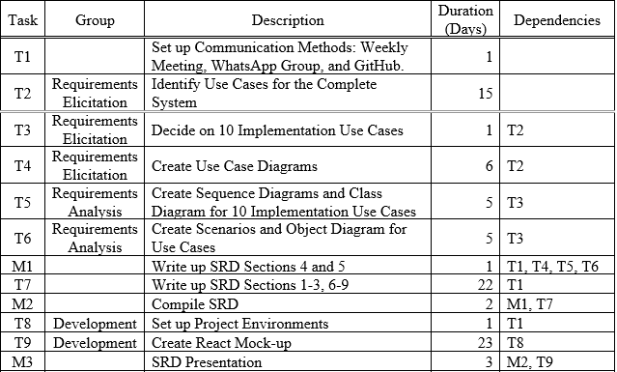
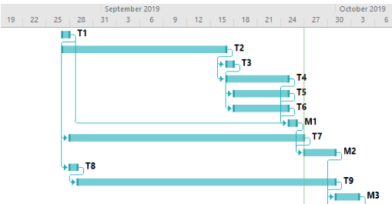
Project Schedule

Slide 4
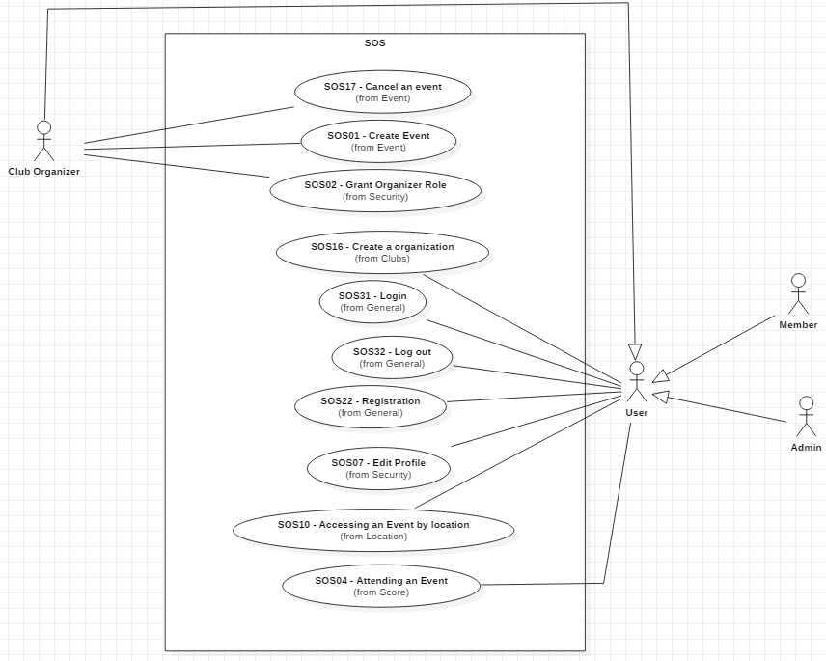
UML Diagram

Slide 5
Use Case SOS16 Create Organization
Functional Requirements
1. User must have an account in the webpage and logged in.
2. User clicks on “Organization Tab.”
3. The webpage switches to organization page.
4. User click on “Create Organization.”
5. User then fills out form asking for the organization details.
6. User submits form to webpage.
7. User then sees their newly created organization on the screen and is the leader of said organization.

Slide 6
Use Case SOS16 Create Organization
Nonfunctional Requirements
Usability
On average the user should take 2 minutes to complete the request.
Reliability
Mean time to failure – 5% failures for every month of operation is acceptable.
Performance
Request should be sent and saved within 6 seconds.
System should be able to handle 200 requests in 1 minute.
Implementation
JS & React (front end), Java and MySQL (back-end).

Slide 7
Use Case SOS07 Edit Profile (Security)
Functional Requirements:
1. User must have an account in the system and be logged in.
2. User is in their profile page and clicks “Edit Profile.”
3. User is then shown their current information in an editable form.
4. User inputs the data they would like to change.
5. User submits the request to change their information.
6. The webpage prompts the user for their password.
7. User inputs password and submits then system authenticates their request.
8. System then changes in the data storage.
9. User receives notification that their profile has been successfully edited.

Slide 8
Use Case SOS07 Edit Profile (Security)
Nonfunctional Requirements
Usability
User must be aware of their privileges and what actions those privileges permit.
Availability
Downtime for Login Back-up – 30 minutes in a 24-hour period.
Performance
The system should handle 20 privilege checks in 1 minute.
The system should be done with the edit request within 2 seconds.
Supportability
Should be supported by all browsers.

Slide 9
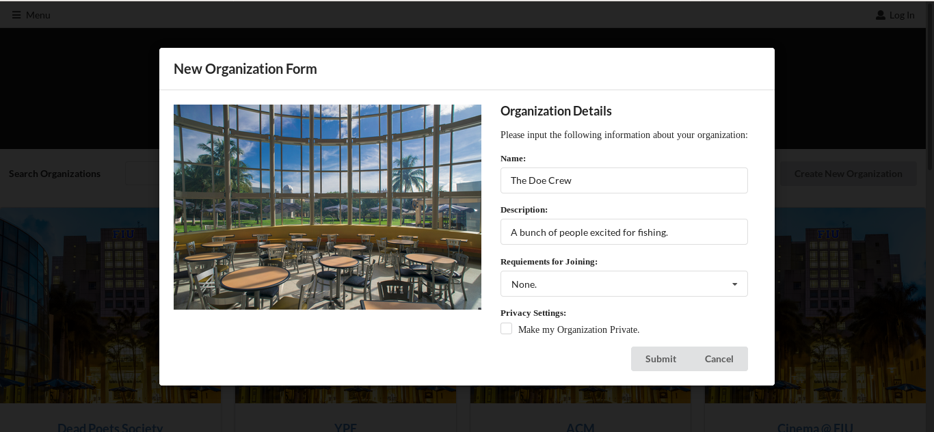
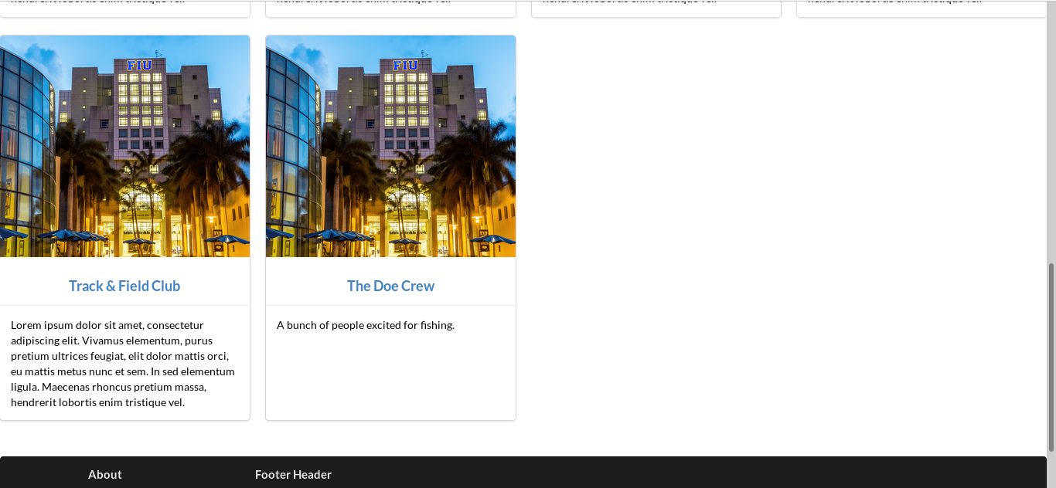
User Interface Design SOS16

Slide 10
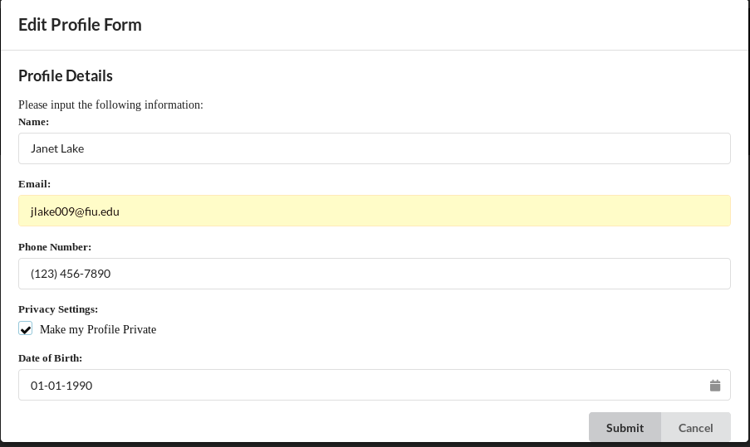
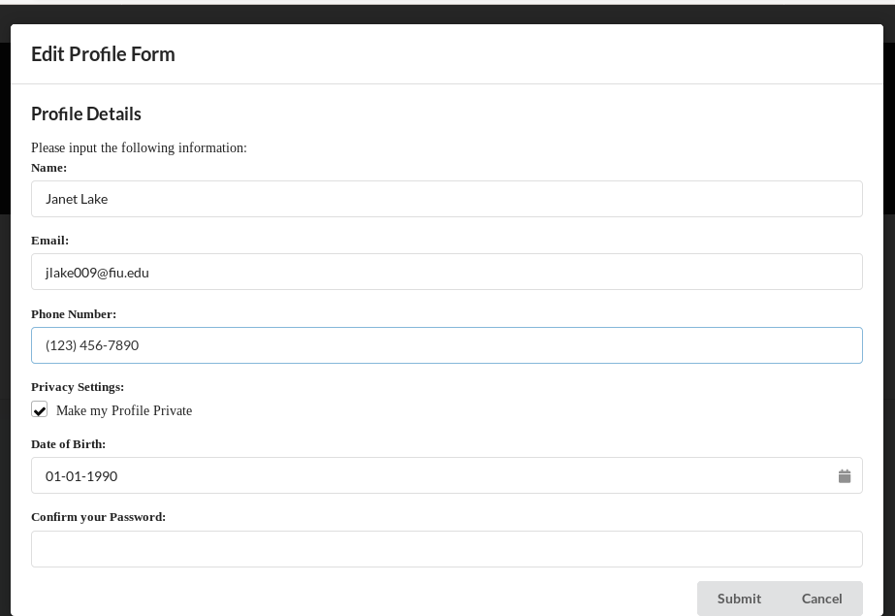
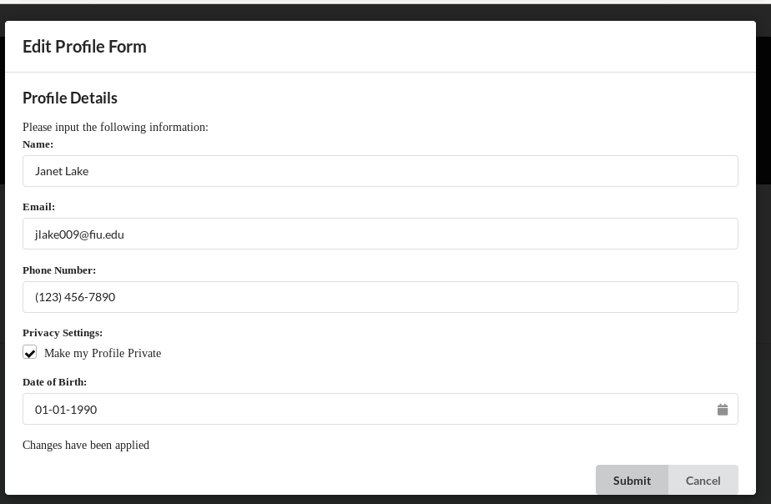
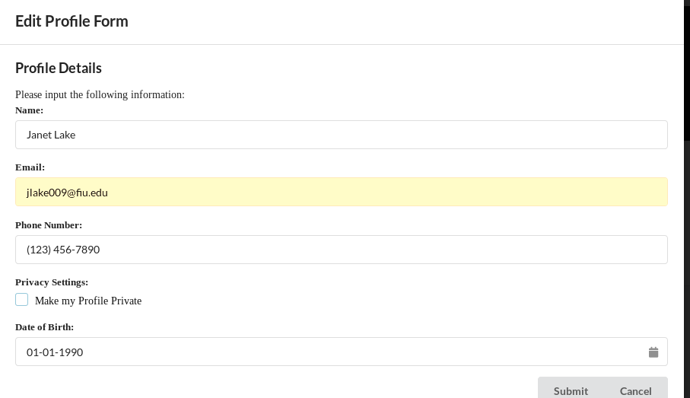
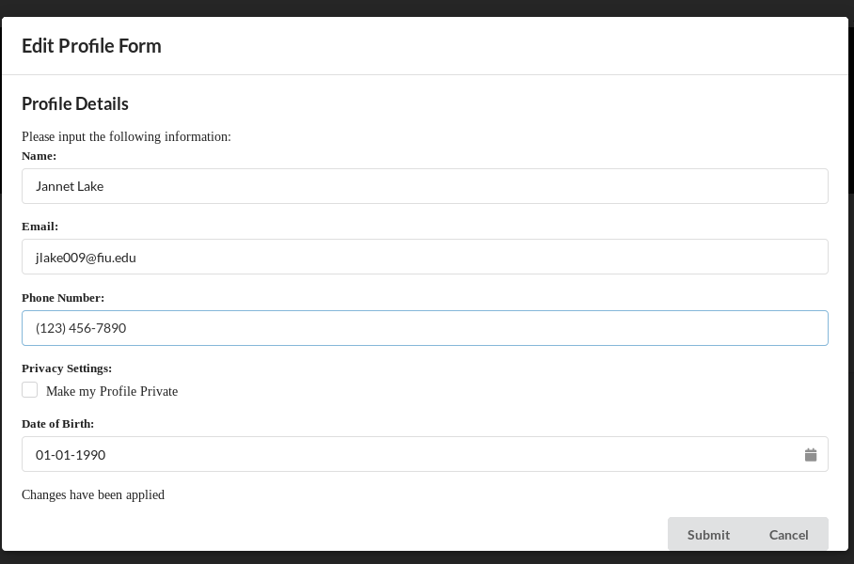
User Interface Design SOS07

Slide 11
Requirement Analysis SOS16
Entities
User
Organization
Role
Boundary
Organization Page
Control
SOS
Data Storage

Slide 12
Requirement Analysis SOS07
Entity Objects:
User
Boundary Objects:
Profile Page
Edit Profile Form
Control Objects:
SOS
Data Storage

Slide 13
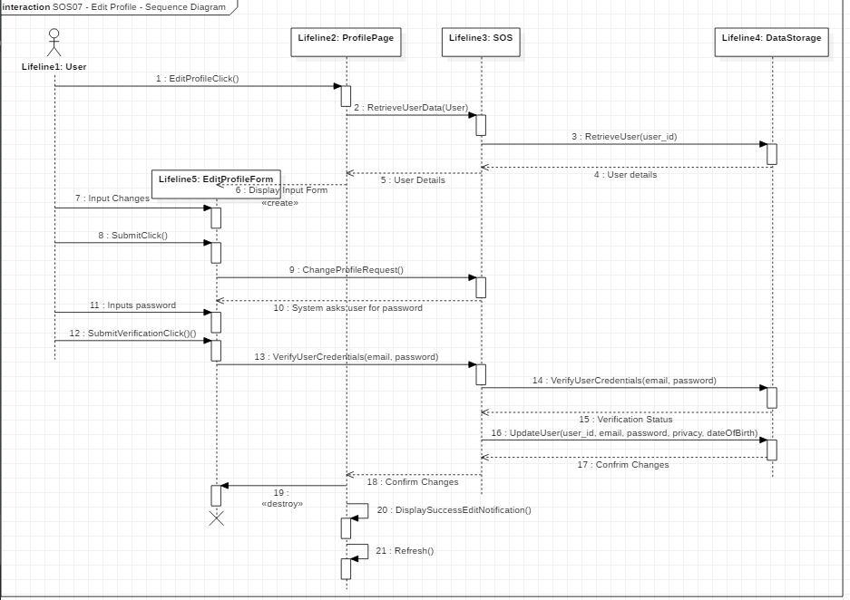
Sequence Diagram SOS07

Slide 14
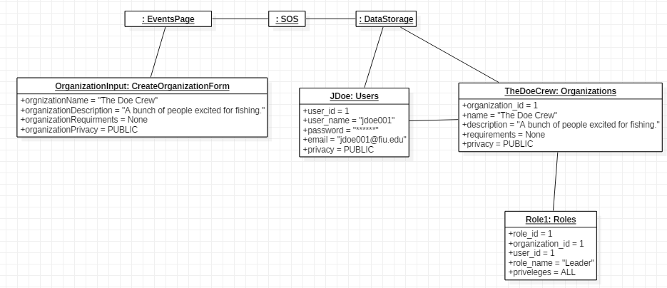
Object Diagram SOS16
Notes:
Change object diagram

Slide 15
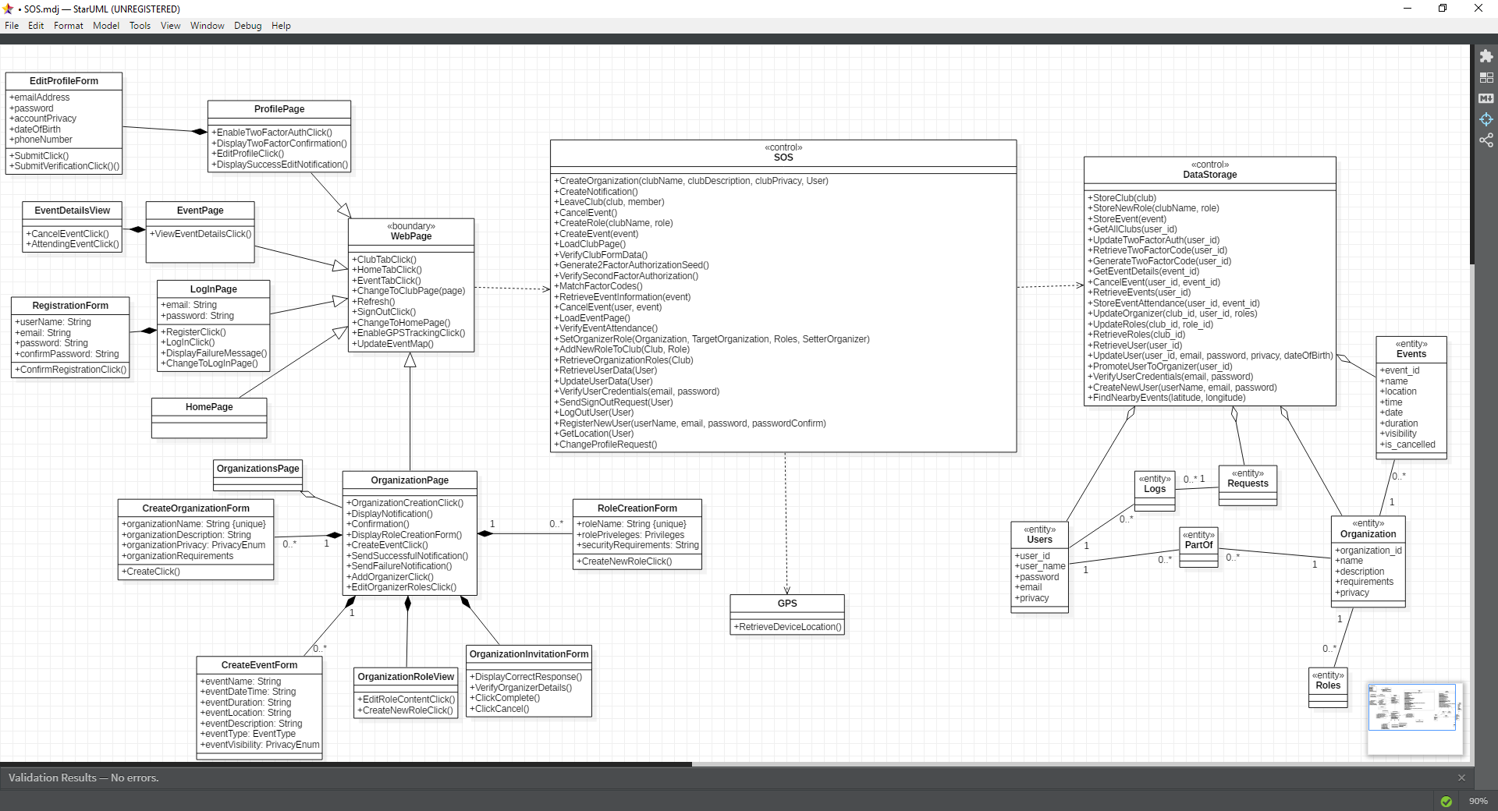
Class Diagram for SOS
Notes:
Change class diagram

